Slide 1


PIZZA SHOP
SQL INSIGHTS

Slide 2

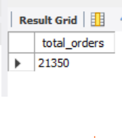

Retrieve the total number of orders placed

Slide 3


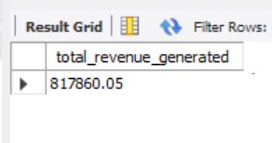
Calculate the total revenue generated from pizza sales

Slide 4

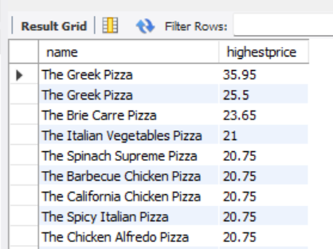

Identify the highest-priced pizza

Slide 5

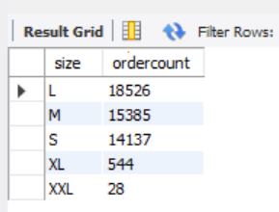

Identify the most common pizza size ordered

Slide 6


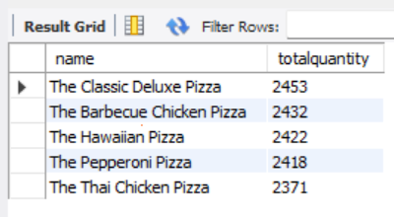
List the top 5 most ordered pizza types along with their quantities

Slide 7

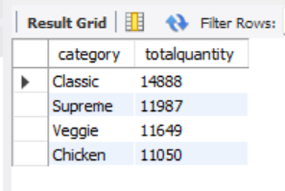
Join the necessary tables to find the total quantity of each pizza category ordered

Slide 8
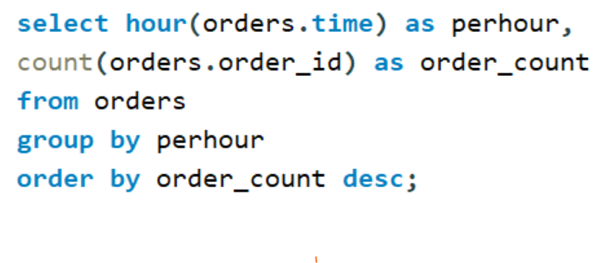
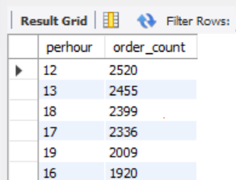
Determine the distribution of orders by hour of the day

Slide 9

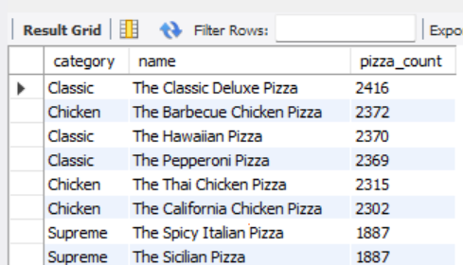
Join relevant tables to find the category-wise distribution of pizzas

Slide 10

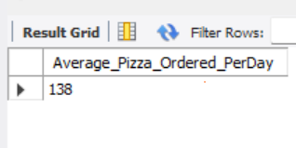
Group the orders by date and calculate the average number of pizzas ordered per day

Slide 11

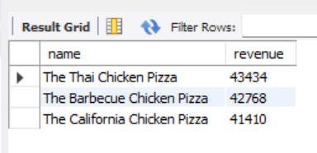
Determine the top 3 most ordered pizza types based on revenue

Slide 12
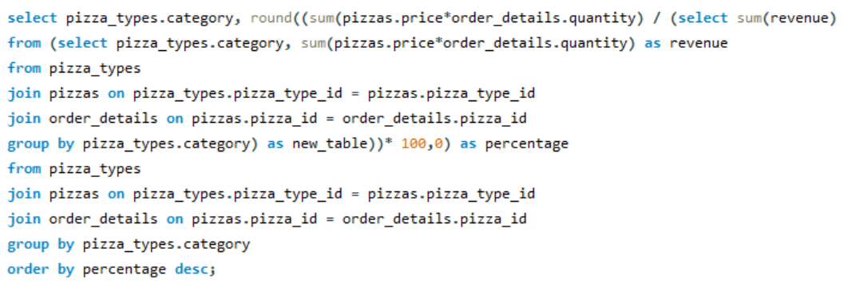
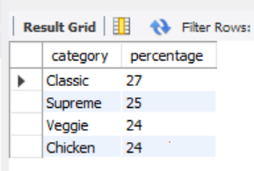
Calculate the percentage contribution of each pizza type to total revenue

Slide 13

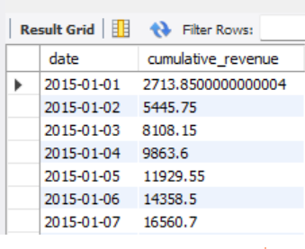
Analyze the cumulative revenue generated over time

Slide 14
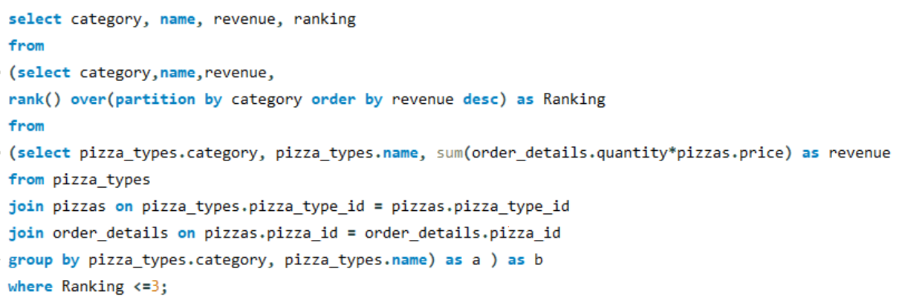
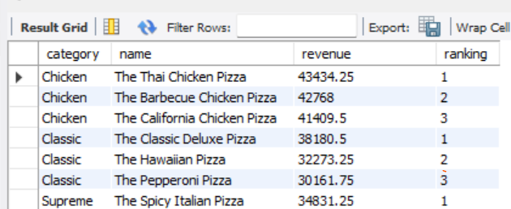
Determine the top 3 most ordered pizza types based on revenue for each pizza category

Slide 15
PIZZA PARTY!

